Slide 1
Dr YSR Aarogyasri Health Cards
Notes:
Title slide with customer logo
Customer logo to be placed on the right
Use this slide if you need to create a presentation in conjunction/partnership with a
client/customer. Logo placement cannot be changed
Title should not exceed beyond 3 lines, font size 30-34, Arial Headings (Font size for the title of
the PPT can vary between 30-34, Arial Headings, Bold depending on the amount of text, however should not be
smaller than 30 font size)
Name should not exceed beyond 1 line, Designation should not exceed beyond 1 line , font size to
remain at 18,Arial Headings
Keep this slide simple just the logo, title, name and designation to appear.
No other graphic elements or any design, photograph, image can be added to this slide , alignment to remain the same
1

Slide 2
Activities of Digital Assistants/Ward Health Secretaries.
New application Registration for Health Card
Member Addition, Deletion and Modify on existing cards.
Check status of the Request / Health Card
Digital health Card Print
Acknowledgement against Printed Health cards received by DA/WHS
Information on Network Hospitals and Procedure list.
Support Team email:-aarogyasrihealthcards@ysraarogyasri.ap.gov.in
Notes:
Title slide with customer logo
Customer logo to be placed on the right
Use this slide if you need to create a presentation in conjunction/partnership with a
client/customer. Logo placement cannot be changed
Title should not exceed beyond 3 lines, font size 30-34, Arial Headings (Font size for the title of
the PPT can vary between 30-34, Arial Headings, Bold depending on the amount of text, however should not be
smaller than 30 font size)
Name should not exceed beyond 1 line, Designation should not exceed beyond 1 line , font size to
remain at 18,Arial Headings
Keep this slide simple just the logo, title, name and designation to appear.
No other graphic elements or any design, photograph, image can be added to this slide , alignment to remain the same
2

Slide 3
District wise Health Cards Distributed Report as on 24.11.2020
S.No. | District Name | Pre-Populated Cards Dispactched |  |  | New Health Cards |  |  | Grand Total
 |  | Dispatched | Delivered | Yet to Deliver | Dispatched | Delivered | Yet to Deliver | Dispatched | Delivered | Yet to Deliver
(A) | (B) | (C) | (D) | (E) | (F) | (G) | (H) | (C+F) | (D+G) | (E+H)
1 | ANANTHAPUR | 12,09,419 | 11,80,860 | 28,559 | 3,362 | 815 | 2,547 | 12,12,781 | 11,81,675 | 31,106
2 | CHITTOOR | 10,94,844 | 10,94,084 | 760 | 5,929 | 1,275 | 4,654 | 11,00,773 | 10,95,359 | 5,414
3 | EAST GODAVARI | 16,06,686 | 16,06,639 | 47 | 7,416 | 1,449 | 5,967 | 16,14,102 | 16,08,088 | 6,014
4 | GUNTUR | 14,44,659 | 14,34,260 | 10,399 | 10,699 | 3,284 | 7,415 | 14,55,358 | 14,37,544 | 17,814
5 | KADAPA | 7,77,236 | 7,53,274 | 23,962 | 4,319 | 859 | 3,460 | 7,81,555 | 7,54,133 | 27,422
6 | KRISHNA | 12,32,120 | 12,03,093 | 29,027 | 17,031 | 3,926 | 13,105 | 12,49,151 | 12,07,019 | 42,132
7 | KURNOOL | 11,47,162 | 11,25,239 | 21,923 | 5,597 | 1,346 | 4,251 | 11,52,759 | 11,26,585 | 26,174
8 | PRAKASAM | 9,54,452 | 9,54,193 | 259 | 6,204 | 1,621 | 4,583 | 9,60,656 | 9,55,814 | 4,842
9 | SPSR NELLORE | 8,75,548 | 8,62,873 | 12,675 | 5,044 | 1,480 | 3,564 | 8,80,592 | 8,64,353 | 16,239
10 | SRIKAKULAM | 7,91,024 | 7,74,135 | 16,889 | 2,473 | 389 | 2,084 | 7,93,497 | 7,74,524 | 18,973
11 | VISAKHAPATNAM | 12,27,566 | 11,88,739 | 38,827 | 13,278 | 1,827 | 11,451 | 12,40,844 | 11,90,566 | 50,278
12 | VIZIANAGARAM | 6,99,892 | 6,89,732 | 10,160 | 1,939 | 355 | 1,584 | 7,01,831 | 6,90,087 | 11,744
13 | WEST GODAVARI | 12,23,116 | 12,04,729 | 18,387 | 5,164 | 843 | 4,321 | 12,28,280 | 12,05,572 | 22,708
Totals |  | 1,42,83,724 | 1,40,71,850 | 2,11,874 | 88,455 | 19,469 | 68,986 | 1,43,72,179 | 1,40,91,319 | 2,80,860
Notes:
Title slide with customer logo
Customer logo to be placed on the right
Use this slide if you need to create a presentation in conjunction/partnership with a
client/customer. Logo placement cannot be changed
Title should not exceed beyond 3 lines, font size 30-34, Arial Headings (Font size for the title of
the PPT can vary between 30-34, Arial Headings, Bold depending on the amount of text, however should not be
smaller than 30 font size)
Name should not exceed beyond 1 line, Designation should not exceed beyond 1 line , font size to
remain at 18,Arial Headings
Keep this slide simple just the logo, title, name and designation to appear.
No other graphic elements or any design, photograph, image can be added to this slide , alignment to remain the same
3

Slide 4
Eligible Criteria for all Households as per G.O.Rt.No.628 dt:15.11.2019
All Rice Card Holders are eligible.
Families which are eligible for YSR Pension Kanuka Card and Jagananna Vidya and Vasathi Deevena Card are also eligible.
Land owners holding:
a. Less than 12.00 Acres of wet land
b. Less than 35.00 Acres of dry land
c. Total less than 35.00 Acres (Wet & Dry)
Annual income of the Households:
a. All households whose annual income is less than or up
to Rs.5.00 Lakhs (Salary certificate evidence)
b. Income Tax Payers: Families who are filing Income Tax
Returns for annual income up to Rs.5.00 Lakhs are
eligible (Income Tax Return evidence).
5. Employees: Any employee, other than permanent Government employee/ pensioner, whose annual income is less than or upto
Rs.5.00 Lakhs is eligible. It includes outsourcing, Contract, Part time employees, Sanitary workers, Honorarium based employees
working in Government sector and employees of Private sector.
6. Municipal Property Tax Payers: All households paying Municipal Property Tax for the area less than 3000 SFT (334 Sq. Yds)
7. Personal Vehicle: Families/Households not having more than one personal car.
Notes:
Title slide with customer logo
Customer logo to be placed on the right
Use this slide if you need to create a presentation in conjunction/partnership with a
client/customer. Logo placement cannot be changed
Title should not exceed beyond 3 lines, font size 30-34, Arial Headings (Font size for the title of
the PPT can vary between 30-34, Arial Headings, Bold depending on the amount of text, however should not be
smaller than 30 font size)
Name should not exceed beyond 1 line, Designation should not exceed beyond 1 line , font size to
remain at 18,Arial Headings
Keep this slide simple just the logo, title, name and designation to appear.
No other graphic elements or any design, photograph, image can be added to this slide , alignment to remain the same
4

Slide 5
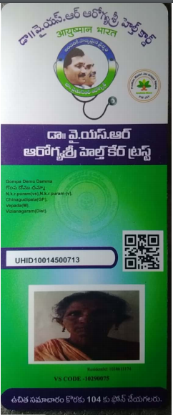
Service Name : New Aarogyasri Health Card
Department Name : Dr YSR Aarogyasri Health Care Trust
Health Card
Notes:
Title slide with customer logo
Customer logo to be placed on the right
Use this slide if you need to create a presentation in conjunction/partnership with a
client/customer. Logo placement cannot be changed
Title should not exceed beyond 3 lines, font size 30-34, Arial Headings (Font size for the title of
the PPT can vary between 30-34, Arial Headings, Bold depending on the amount of text, however should not be
smaller than 30 font size)
Name should not exceed beyond 1 line, Designation should not exceed beyond 1 line , font size to
remain at 18,Arial Headings
Keep this slide simple just the logo, title, name and designation to appear.
No other graphic elements or any design, photograph, image can be added to this slide , alignment to remain the same
5

Slide 6
New Application Enrollment:
Login to Grama Ward Sachivalayam portal
Open an Internet Browser (Google Chrome)
Enter the following URL https://gramawardsachivalayam.ap.gov.in/GSWS/Home/Main
Once the above portal is opened, from the righthand side corner, click on LOGIN
Login screen will be displayed as shown:
Enter Username, Password and Captcha value
Click on Login Now
Notes:
Title slide with customer logo
Customer logo to be placed on the right
Use this slide if you need to create a presentation in conjunction/partnership with a
client/customer. Logo placement cannot be changed
Title should not exceed beyond 3 lines, font size 30-34, Arial Headings (Font size for the title of
the PPT can vary between 30-34, Arial Headings, Bold depending on the amount of text, however should not be
smaller than 30 font size)
Name should not exceed beyond 1 line, Designation should not exceed beyond 1 line , font size to
remain at 18,Arial Headings
Keep this slide simple just the logo, title, name and designation to appear.
No other graphic elements or any design, photograph, image can be added to this slide , alignment to remain the same
6

Slide 7
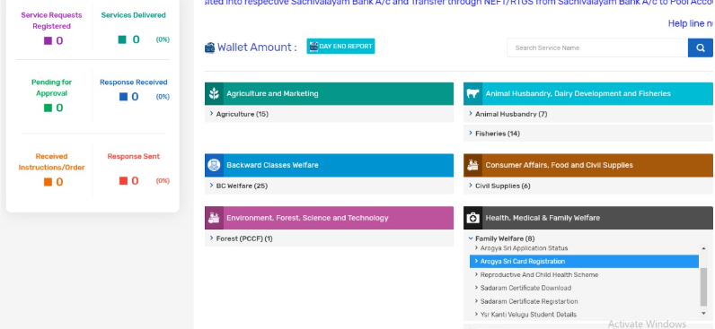
Navigating to Aarogyasri application
Once you login to Grama Ward Sachivalayam portal, navigate towards the end of the page
On the righthand side of the page, you will notice “Aarogyasri Card Registration”
Notes:
Title slide with customer logo
Customer logo to be placed on the right
Use this slide if you need to create a presentation in conjunction/partnership with a
client/customer. Logo placement cannot be changed
Title should not exceed beyond 3 lines, font size 30-34, Arial Headings (Font size for the title of
the PPT can vary between 30-34, Arial Headings, Bold depending on the amount of text, however should not be
smaller than 30 font size)
Name should not exceed beyond 1 line, Designation should not exceed beyond 1 line , font size to
remain at 18,Arial Headings
Keep this slide simple just the logo, title, name and designation to appear.
No other graphic elements or any design, photograph, image can be added to this slide , alignment to remain the same
7

Slide 8
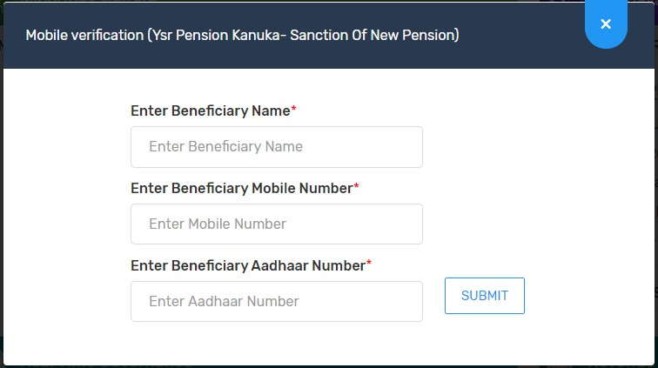
Providing Beneficiary information
On Clicking on “New Application”, a popup window will be shown→
Enter Beneficiary Name: Enter Applicant Name
Enter Beneficiary Mobile Number: Enter Applicant Mobile Number
Enter Beneficiary Aadhaar Number: Enter Applicant Aadhaar Number & click on Submit.
After Submit details Application form displays.
Notes:
Title slide with customer logo
Customer logo to be placed on the right
Use this slide if you need to create a presentation in conjunction/partnership with a
client/customer. Logo placement cannot be changed
Title should not exceed beyond 3 lines, font size 30-34, Arial Headings (Font size for the title of
the PPT can vary between 30-34, Arial Headings, Bold depending on the amount of text, however should not be
smaller than 30 font size)
Name should not exceed beyond 1 line, Designation should not exceed beyond 1 line , font size to
remain at 18,Arial Headings
Keep this slide simple just the logo, title, name and designation to appear.
No other graphic elements or any design, photograph, image can be added to this slide , alignment to remain the same
8

Slide 9
Filling the Application form
Once the application form is opened, follow the Steps below to fill the application form
Select Volunteer Name and Application Entry date
Select “No” for any rice card/Jagan anna vidya deevena/Jagan anna Vasati Deevena/Jagan anna Pension kanuka,
Enter AADHAAR number of applicant/Beneficiary
Click on get details
Notes:
Title slide with customer logo
Customer logo to be placed on the right
Use this slide if you need to create a presentation in conjunction/partnership with a
client/customer. Logo placement cannot be changed
Title should not exceed beyond 3 lines, font size 30-34, Arial Headings (Font size for the title of
the PPT can vary between 30-34, Arial Headings, Bold depending on the amount of text, however should not be
smaller than 30 font size)
Name should not exceed beyond 1 line, Designation should not exceed beyond 1 line , font size to
remain at 18,Arial Headings
Keep this slide simple just the logo, title, name and designation to appear.
No other graphic elements or any design, photograph, image can be added to this slide , alignment to remain the same
9

Slide 10
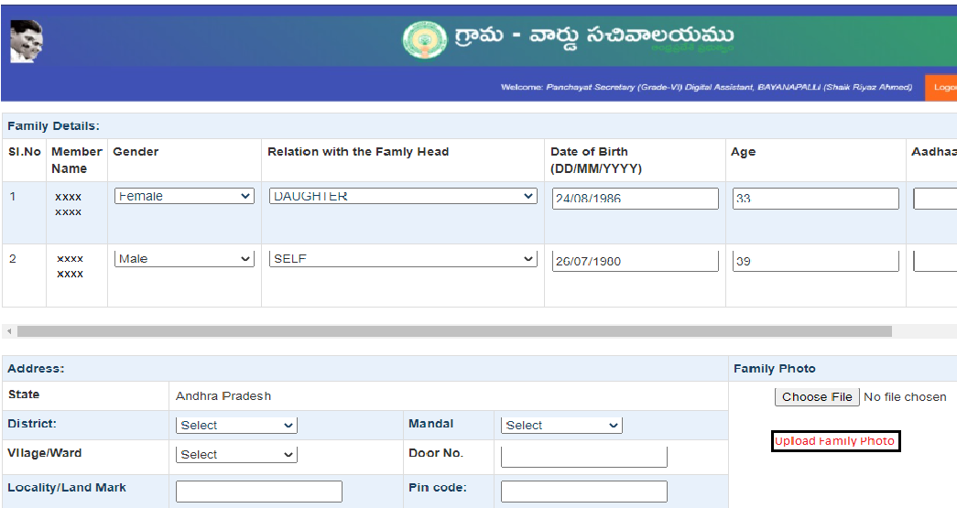
Verify the Beneficiary information
Verify the family member details and modify if any change need.
Upload the family photo of concerned.
Notes:
Title slide with customer logo
Customer logo to be placed on the right
Use this slide if you need to create a presentation in conjunction/partnership with a
client/customer. Logo placement cannot be changed
Title should not exceed beyond 3 lines, font size 30-34, Arial Headings (Font size for the title of
the PPT can vary between 30-34, Arial Headings, Bold depending on the amount of text, however should not be
smaller than 30 font size)
Name should not exceed beyond 1 line, Designation should not exceed beyond 1 line , font size to
remain at 18,Arial Headings
Keep this slide simple just the logo, title, name and designation to appear.
No other graphic elements or any design, photograph, image can be added to this slide , alignment to remain the same
10

Slide 11
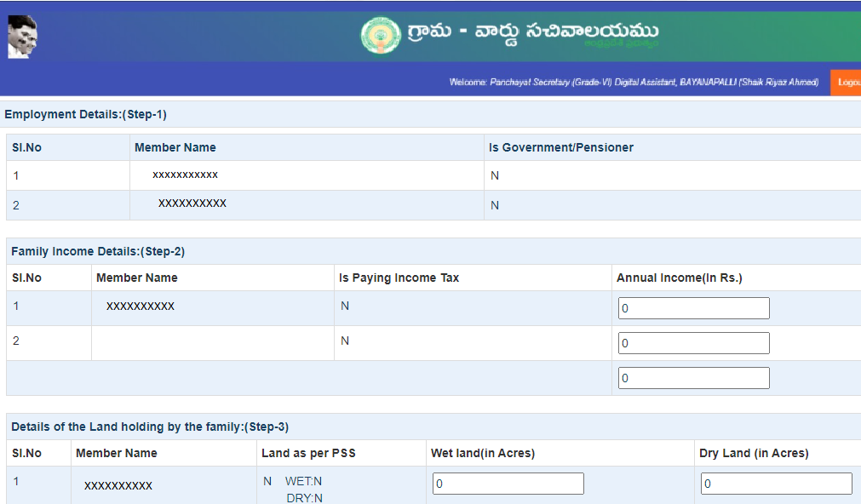
Verify the details 5 step information
Step 1: Employment Details.
Step 2 : Family Income details.
Step 3 : Details of the Land Holding of the family.
Step 4 : Property TAX details
Step 5: No. of cars owned by Family.
Notes:
Title slide with customer logo
Customer logo to be placed on the right
Use this slide if you need to create a presentation in conjunction/partnership with a
client/customer. Logo placement cannot be changed
Title should not exceed beyond 3 lines, font size 30-34, Arial Headings (Font size for the title of
the PPT can vary between 30-34, Arial Headings, Bold depending on the amount of text, however should not be
smaller than 30 font size)
Name should not exceed beyond 1 line, Designation should not exceed beyond 1 line , font size to
remain at 18,Arial Headings
Keep this slide simple just the logo, title, name and designation to appear.
No other graphic elements or any design, photograph, image can be added to this slide , alignment to remain the same
11

Slide 12
Submission of Application form:
Select the check box of Declaration.
Click on “Submit data” for final submission of the New application form.
A request number has been generated for future communication purpose.
Note: If any deviation found, the application will be considered as Ineligible.
Notes:
Title slide with customer logo
Customer logo to be placed on the right
Use this slide if you need to create a presentation in conjunction/partnership with a
client/customer. Logo placement cannot be changed
Title should not exceed beyond 3 lines, font size 30-34, Arial Headings (Font size for the title of
the PPT can vary between 30-34, Arial Headings, Bold depending on the amount of text, however should not be
smaller than 30 font size)
Name should not exceed beyond 1 line, Designation should not exceed beyond 1 line , font size to
remain at 18,Arial Headings
Keep this slide simple just the logo, title, name and designation to appear.
No other graphic elements or any design, photograph, image can be added to this slide , alignment to remain the same
12

Slide 13
Sub SLAs for New Health Card
DAY | ACTIVITY
Day 1 | Receiving of the application, submit and System Validations by RTGS service.
Day 2- 6 | Respective department and District Coordinator – Aarogyasri verification
Day 7 | Generate UHID and Approve Health Cards
Day 8 | Generate PDFs and Sent to Printers.
Day 9 – 19 | Printing and Transportation to respective secretariats
Day 20 | Distribution of Health card to concerned beneficiary and update the delivered Health card status.
Note: A temporary Digital Health card will be generated and made available to take print after health card approval i.e from day 7.
Note: The entire process for issuing of new Health Card shall be completed in a period of 20 days.
Notes:
Title slide with customer logo
Customer logo to be placed on the right
Use this slide if you need to create a presentation in conjunction/partnership with a
client/customer. Logo placement cannot be changed
Title should not exceed beyond 3 lines, font size 30-34, Arial Headings (Font size for the title of
the PPT can vary between 30-34, Arial Headings, Bold depending on the amount of text, however should not be
smaller than 30 font size)
Name should not exceed beyond 1 line, Designation should not exceed beyond 1 line , font size to
remain at 18,Arial Headings
Keep this slide simple just the logo, title, name and designation to appear.
No other graphic elements or any design, photograph, image can be added to this slide , alignment to remain the same
13

Slide 14
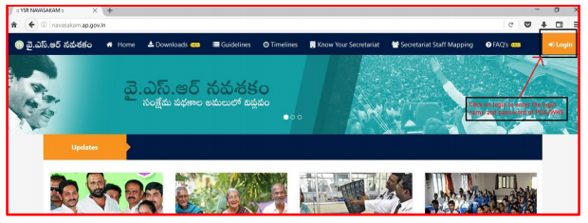
2. Member Addition, Delete and Modify
Step 1: Open the Web URL of Navasakam portal (navasakam.ap.gov.in) . The same option will be provided in GSWS portal shortly..
Step 2 : Download the application form for New Health card, Add member details, Delete and Edit member details as per the screenshot shown below.
Notes:
Title slide with customer logo
Customer logo to be placed on the right
Use this slide if you need to create a presentation in conjunction/partnership with a
client/customer. Logo placement cannot be changed
Title should not exceed beyond 3 lines, font size 30-34, Arial Headings (Font size for the title of
the PPT can vary between 30-34, Arial Headings, Bold depending on the amount of text, however should not be
smaller than 30 font size)
Name should not exceed beyond 1 line, Designation should not exceed beyond 1 line , font size to
remain at 18,Arial Headings
Keep this slide simple just the logo, title, name and designation to appear.
No other graphic elements or any design, photograph, image can be added to this slide , alignment to remain the same
14

Slide 15
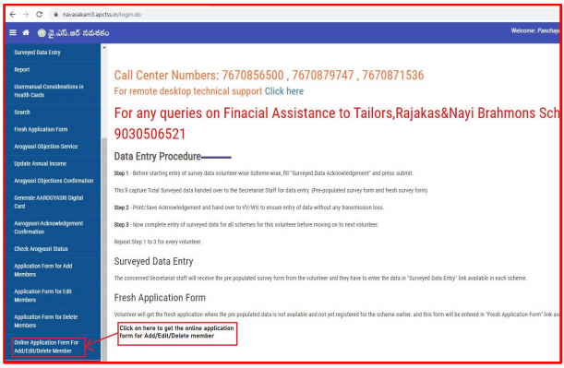
Click on online application form for Add/Edit/Delete member as shown in the screenshot 1.
Screenshot 2
Enter the valid UHID and click on “Get Data” to fetch the details of the family members as shown in the screenshot 2.
Screenshot 1
Notes:
Title slide with customer logo
Customer logo to be placed on the right
Use this slide if you need to create a presentation in conjunction/partnership with a
client/customer. Logo placement cannot be changed
Title should not exceed beyond 3 lines, font size 30-34, Arial Headings (Font size for the title of
the PPT can vary between 30-34, Arial Headings, Bold depending on the amount of text, however should not be
smaller than 30 font size)
Name should not exceed beyond 1 line, Designation should not exceed beyond 1 line , font size to
remain at 18,Arial Headings
Keep this slide simple just the logo, title, name and designation to appear.
No other graphic elements or any design, photograph, image can be added to this slide , alignment to remain the same
15

Slide 16
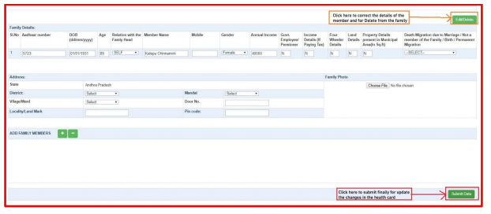
You will get the details of the family as per exists in the Household survey in GSWS.
Delete Member: Please click on the Edit/Delete link as shown and select the appropriate reason for delete “1. Death 2. Not a family Member 3. Permanent Migration and 4. Migration due to marriage.
Modify member: Please click on the Edit/Delete link as shown and select the appropriate reason for Modify “Age, Gender, Mobile Number, Relationship with head of the family and Address”
Add member details: click on “+” and click on “-“ for deleting the excess rows as shown in the screenshot below. Enter the aadhar number of the respective member and wait for 2 seconds for getting the details along with 5 step values (Aadhaar number is not mandatory for member below 5 yrs)
Notes:
Title slide with customer logo
Customer logo to be placed on the right
Use this slide if you need to create a presentation in conjunction/partnership with a
client/customer. Logo placement cannot be changed
Title should not exceed beyond 3 lines, font size 30-34, Arial Headings (Font size for the title of
the PPT can vary between 30-34, Arial Headings, Bold depending on the amount of text, however should not be
smaller than 30 font size)
Name should not exceed beyond 1 line, Designation should not exceed beyond 1 line , font size to
remain at 18,Arial Headings
Keep this slide simple just the logo, title, name and designation to appear.
No other graphic elements or any design, photograph, image can be added to this slide , alignment to remain the same
16

Slide 17
3. Check Request status or Health Card Status
Open the Web URL of Navasakam portal (navasakam.ap.gov.in)
Click on the service link “Check Aarogyasri Status” as shown in the screenshot.
Click on “Check Status” by sumitting either Old rataion card/Request No or UHID or Any Aadhar No. of the family member.
Notes:
Title slide with customer logo
Customer logo to be placed on the right
Use this slide if you need to create a presentation in conjunction/partnership with a
client/customer. Logo placement cannot be changed
Title should not exceed beyond 3 lines, font size 30-34, Arial Headings (Font size for the title of
the PPT can vary between 30-34, Arial Headings, Bold depending on the amount of text, however should not be
smaller than 30 font size)
Name should not exceed beyond 1 line, Designation should not exceed beyond 1 line , font size to
remain at 18,Arial Headings
Keep this slide simple just the logo, title, name and designation to appear.
No other graphic elements or any design, photograph, image can be added to this slide , alignment to remain the same
17

Slide 18
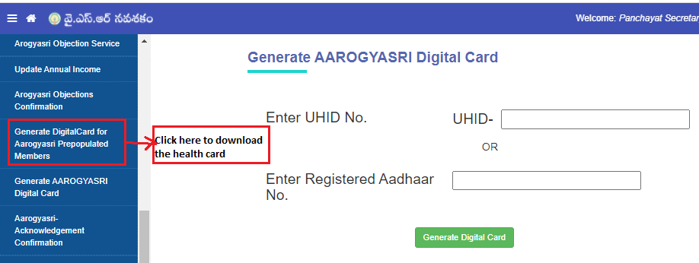
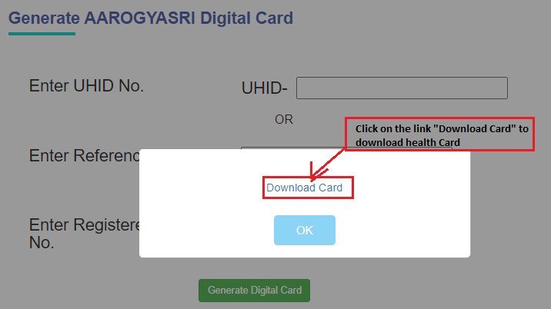
5. Download Digital health Card for Pre-Populated
Click on the service link “Generate Digital health card for aarogyasri Prepopulated” and click on “Generate Digital Card” by submitting UHID or Any one Aadhar no. of the family member
Click on the link “Download Card” to Download health and take a print and handed over to beneficiary.
Notes:
Title slide with customer logo
Customer logo to be placed on the right
Use this slide if you need to create a presentation in conjunction/partnership with a
client/customer. Logo placement cannot be changed
Title should not exceed beyond 3 lines, font size 30-34, Arial Headings (Font size for the title of
the PPT can vary between 30-34, Arial Headings, Bold depending on the amount of text, however should not be
smaller than 30 font size)
Name should not exceed beyond 1 line, Designation should not exceed beyond 1 line , font size to
remain at 18,Arial Headings
Keep this slide simple just the logo, title, name and designation to appear.
No other graphic elements or any design, photograph, image can be added to this slide , alignment to remain the same
18

Slide 19
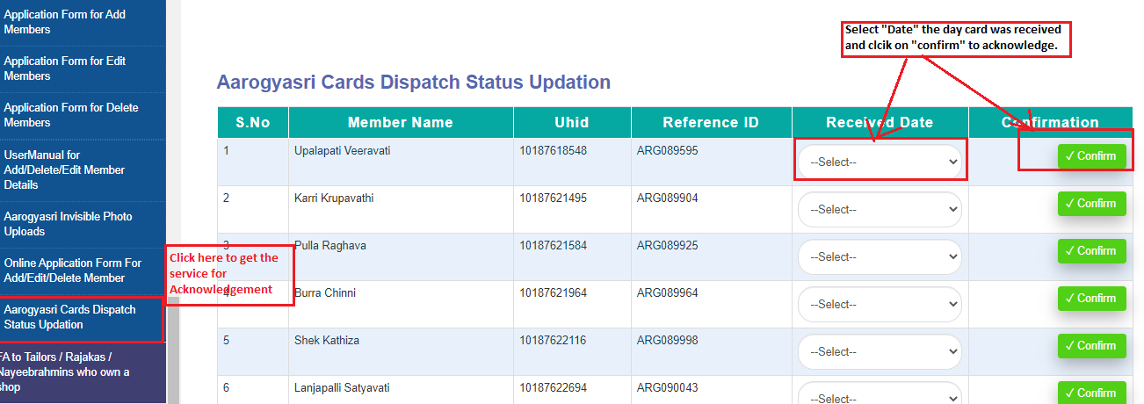
Health Delivery status Acknowledgement by DA/WHS
Click on the service link as shown in the screen then you will get the list of cards which were already delivered then select the “Date” and click on the “Confirm” button to acknowledge.
Notes:
Title slide with customer logo
Customer logo to be placed on the right
Use this slide if you need to create a presentation in conjunction/partnership with a
client/customer. Logo placement cannot be changed
Title should not exceed beyond 3 lines, font size 30-34, Arial Headings (Font size for the title of
the PPT can vary between 30-34, Arial Headings, Bold depending on the amount of text, however should not be
smaller than 30 font size)
Name should not exceed beyond 1 line, Designation should not exceed beyond 1 line , font size to
remain at 18,Arial Headings
Keep this slide simple just the logo, title, name and designation to appear.
No other graphic elements or any design, photograph, image can be added to this slide , alignment to remain the same
19

Slide 20
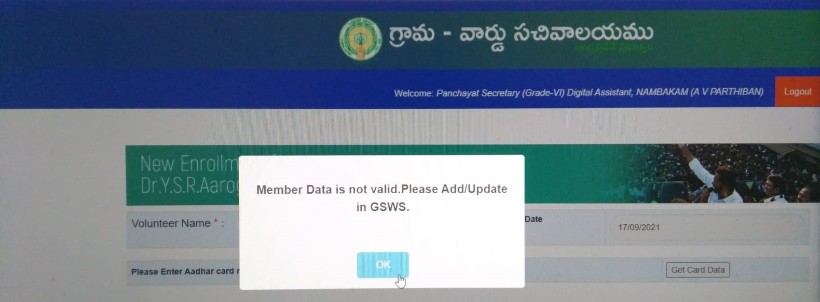
While doing the New Registration if you found this type of alert message : you have to verify with Volunteer Mapping in that one of member name is mapped with “NA” or Aadhar number in place of Name. suggest to update the eKYC details at volunteer.

Slide 21
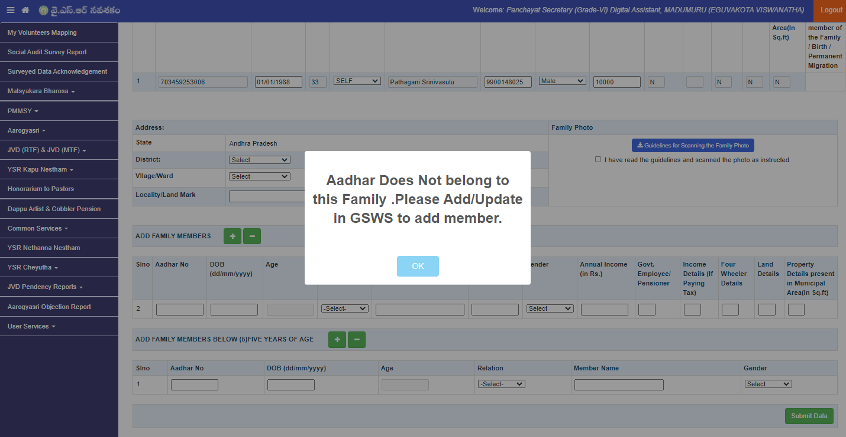
While doing the Addition if you found this type of alert message : you have to verify with Volunteer Mapping in that Head of the Health card Member and the adding person are not in same House Hold id.

Slide 22
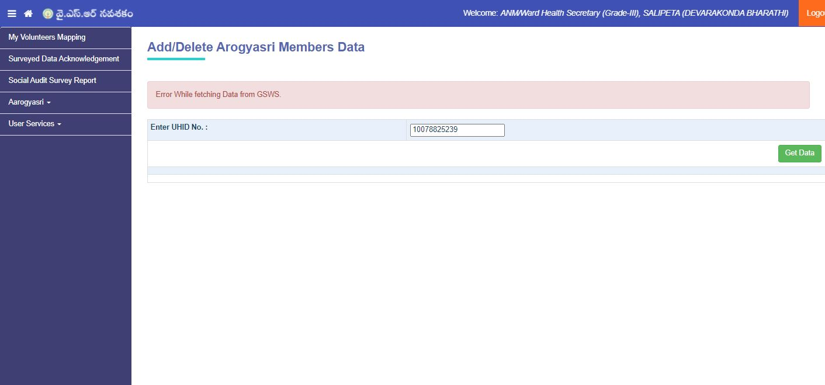
While doing the Modification in Health card if you found this type of alert message : you have to verify with Volunteer Mapping in that Head of the Health card Member are not in volunteer mapping.

Slide 23
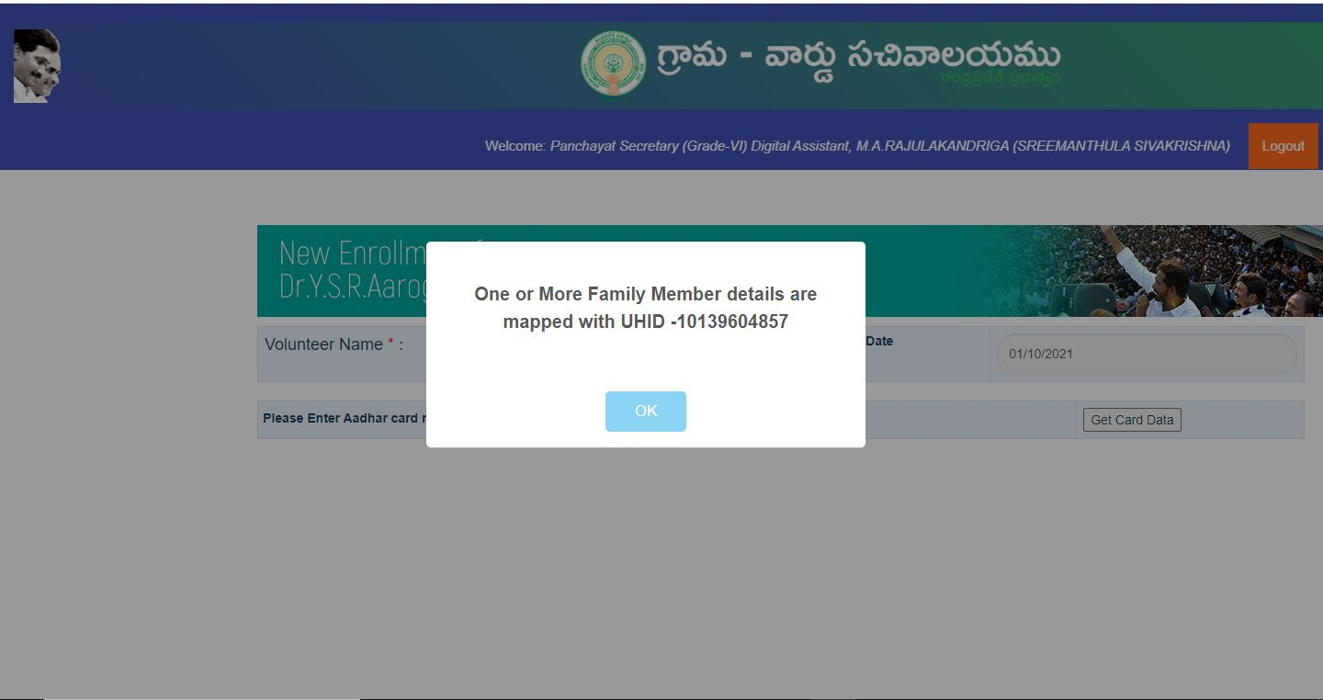
While doing the New Health card if you found this type of alert message : you have to verify with Volunteer Mapping and status of showing UHID if the members have same you have to in to existing Health card.

Slide 24
Support Team
For any queries on Dr YSR Aarogyasri Health Card ?
Contact : aarogyasrihealthcards@ysraarogyasri.ap.gov.in
Thank Q
Notes:
Title slide with customer logo
Customer logo to be placed on the right
Use this slide if you need to create a presentation in conjunction/partnership with a
client/customer. Logo placement cannot be changed
Title should not exceed beyond 3 lines, font size 30-34, Arial Headings (Font size for the title of
the PPT can vary between 30-34, Arial Headings, Bold depending on the amount of text, however should not be
smaller than 30 font size)
Name should not exceed beyond 1 line, Designation should not exceed beyond 1 line , font size to
remain at 18,Arial Headings
Keep this slide simple just the logo, title, name and designation to appear.
No other graphic elements or any design, photograph, image can be added to this slide , alignment to remain the same
24

